Slide 1
Introduction to Point Clouds

Slide 2
What is Point Cloud Data (.pcd)?
A point cloud is just a bunch of tiny 3D points that together form the shape of a real object or environment.
Each point has:
x → left-right
y → forward-backward
z → up-down
Each point shows where something is in 3D space.
No lines or surfaces — just a cloud of dots that shape an object or scene.
It’s like a 3D version of a connect-the-dots image, but without the lines.
Point clouds can also contain extra data:
Color (RGB)
Intensity (how strong the laser reflection was)
Labels (if annotated)
Used to recreate, analyze, or understand the physical world digitally.

Slide 3
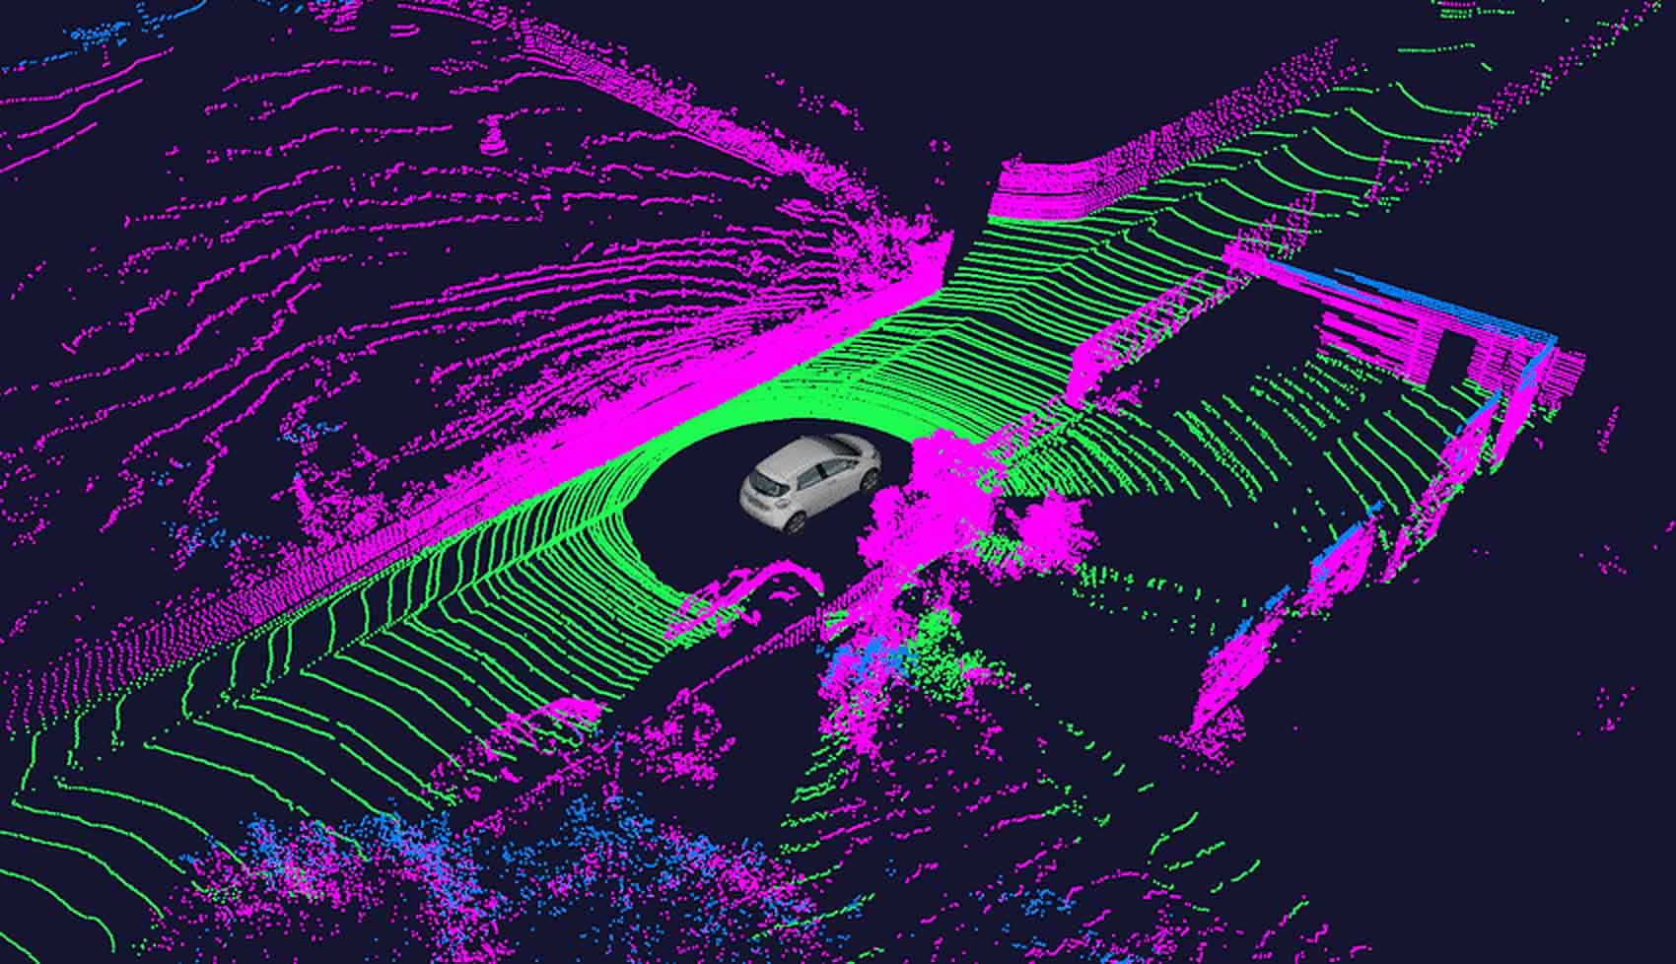
Point Cloud Data

Slide 4
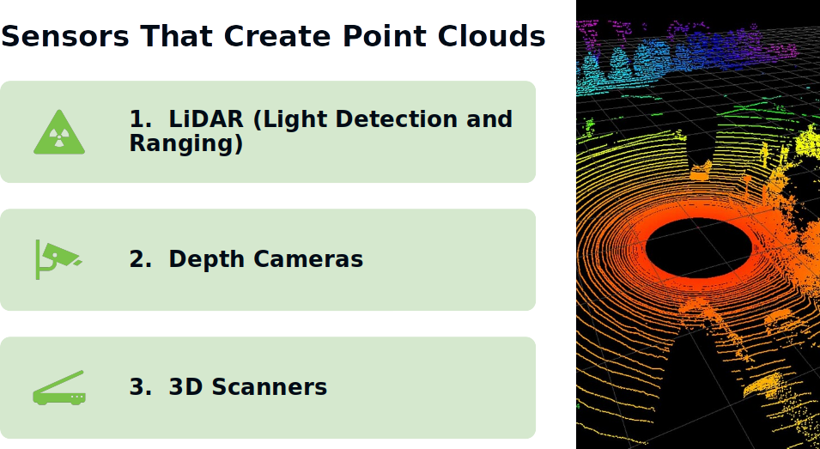

Slide 5
1. LiDAR (Light Detection and Ranging)
Sends laser beams.
Measures time taken for light to return.
Calculates distance for each point.
Builds a 3D view of the surroundings.
Common in: Self-driving cars, robots, drones.

Slide 6
Stereo Cameras
Has two lenses, like our eyes.
Takes two pictures from slightly different angles.
Calculates depth by comparing differences between the two.
Example: Human eye depth perception.
Used in: Robotics, drones, stereo vision systems.

Slide 7
Depth Cameras
Captures how far each pixel is from the camera.
Types:
Stereo Depth Camera – like above.
Structured Light Camera – projects a grid/pattern, sees how it bends.
Time of Flight (ToF) – sends light, measures bounce-back time.
Output: Depth Map (white = close, black = far)
Used in: Face ID, AR/VR, 3D scanning.

Slide 8
Real-World Applications of Point Clouds
A. Robotics
Robots use point clouds to:
Detect and avoid obstacles
Pick and place objects
Navigate in 3D space
B. ADAS (Advanced Driver Assistance Systems)
Cars use LiDAR & cameras to:
Detect vehicles, pedestrians, lanes
Help with braking, parking, and lane-keeping
Power self-driving technology
C. 3D Mapping & Scanning
Architects and surveyors scan buildings/land
3D point clouds help create accurate digital models

Slide 9
PCD File Format Basics

Slide 10
.PCD File?
.pcd = Point Cloud Data file format.
It stores 3D points in a special format.
Each file has:
A header (information about the data)
A list of points (x, y, z, and sometimes rgb)

Slide 11
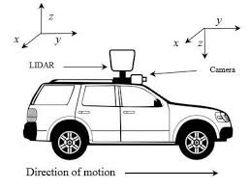
Fields in a .PCD File
(Example: x y z rgb)
x: left-right position
y: up-down position
z: forward-backward position
rgb: color of the point
Think of each point like:
(where it is) + (what color it is)

Slide 12
Fields in a .PCD File
If DATA ascii is used, you can open it in Notepad/VS CODE/Text editor
Each line = one point
Example: 25.2 -19.5 15.4
A 3D point at that position
You can add/edit points by changing numbers (carefully!)

Slide 13
Manually Editing a .PCD File
If DATA ascii is used, you can open it in Notepad/VS CODE/Text editor
Each line = one point
Example: 25.2 -19.5 15.4
A 3D point at that position
You can add/edit points by changing numbers (carefully!)

Slide 14
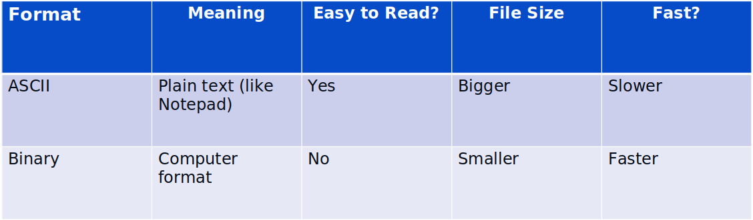
ASCII vs BINARY in .PCD Files
Use ASCII for learning, Binary for performance

Slide 15
Common Header Errors (and Fixes)
Error: POINTS doesn't match the number of lines
Fix: Count lines and update the POINTS value
Error: Wrong FIELDS (e.g., missing rgb)
Fix: Add correct fields based on your data
Error: File says binary but it’s text
Fix: Change DATA ascii or re-save correctly

Slide 16
ASCII Point Example
If header says FIELDS x y z, then each line looks like:
12.5 10.0 3.4
If header says FIELDS x y z rgb, then:
12.5 10.0 3.4 5.62034e-33

Slide 17
What is ASCII?
ASCII = American Standard Code for Information Interchange
It's how computers save text using numbers
In .pcd, ASCII format means:
You can read/edit the points
But it takes more space than binary

Slide 18
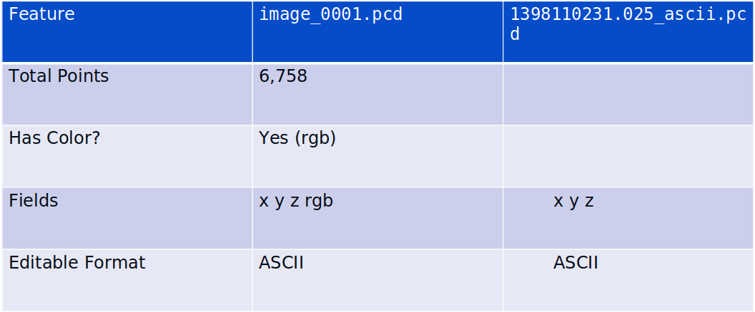
Comparing Two Example Files

Slide 19
PCD File Deep Dive

Slide 20
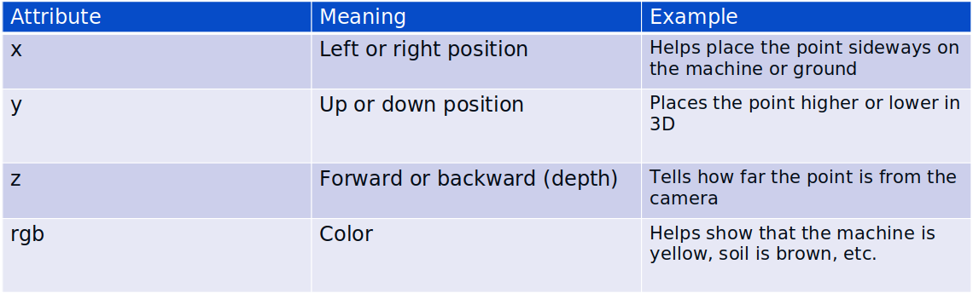
What Are Point Attributes?
Attributes = Extra details stored for each point
Each tiny dot in the image (like the yellow machine, soil, trees) is a 3D point with attributes
In Image each point has:

Slide 21
Loading Point Cloud in Python (Open3D)
Install Open3D - pip install open3d
Load and view file :
import open3d as o3d
Read - pcd = o3d.io.read_point_cloud("image_0002.pcd")
Visualize - o3d.visualization.draw_geometries([pcd])
Save - o3d.io.write_point_cloud("copy.pcd", pcd)

Slide 22
What Does FIELDS x y z rgb Mean?
In .pcd files, FIELDS tells us what each point contains
Example from our file:
FIELDS x y z rgb
This means each point has:
x – left/right position
y – up/down position
z – depth (forward/backward)
rgb – color of the point
Each point = Position + Color

Slide 23
What is Version?
Our file has: VERSION 0.7
This tells the format version of the file
Version 0.7 is commonly used and supported by most tools
No action needed

Slide 24
What is Endianess?
Endianess = how computers store bytes
It only matters in binary files
Our file uses:
DATA ascii - it’s human-readable and editable!

Slide 25
Point Cloud Data Exploration

Slide 26
Objectives :
Inspecting point attributes
Visualizing point clouds in Open3D
Basic statistics (min, max, mean)
Scaling
Normalization
Standardization
Outlier detection
Visualization techniques

Slide 27
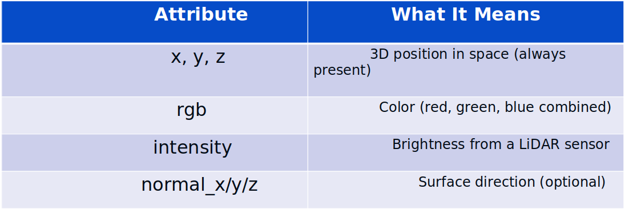
Inspecting Point Attributes
Each point can include:
x = 1.5, y = -2.0, z = 3.0, rgb = 3.4e-38
Use .fields in PCD headers or np.asarray(pcd.points) in Open3D

Slide 28
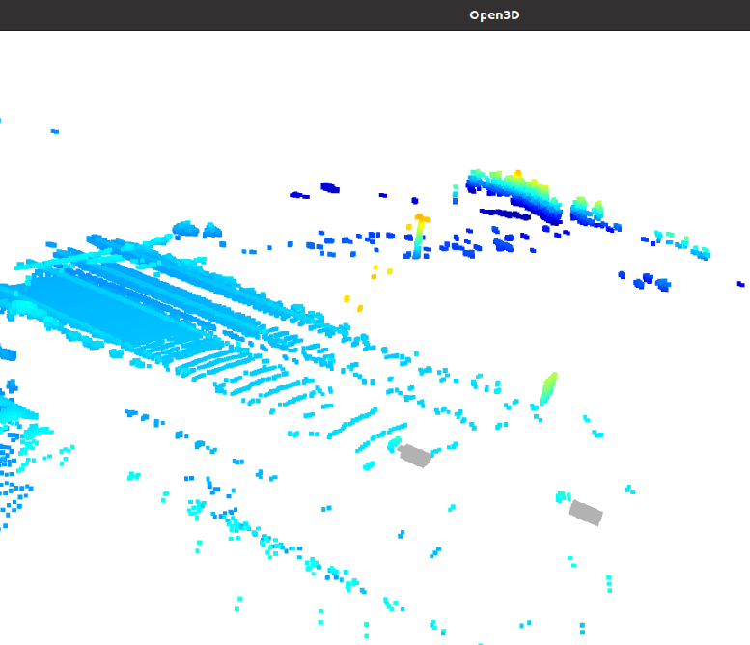
Visualizing Point Clouds in Open3D
import open3d as o3d pcd = o3d.io.read_point_cloud("yourfile.pcd") o3d.visualization.draw_geometries([pcd])
Lets you:
Rotate and zoom the cloud
Visually inspect shape, density, and color
Check noise or misalignment

Slide 29
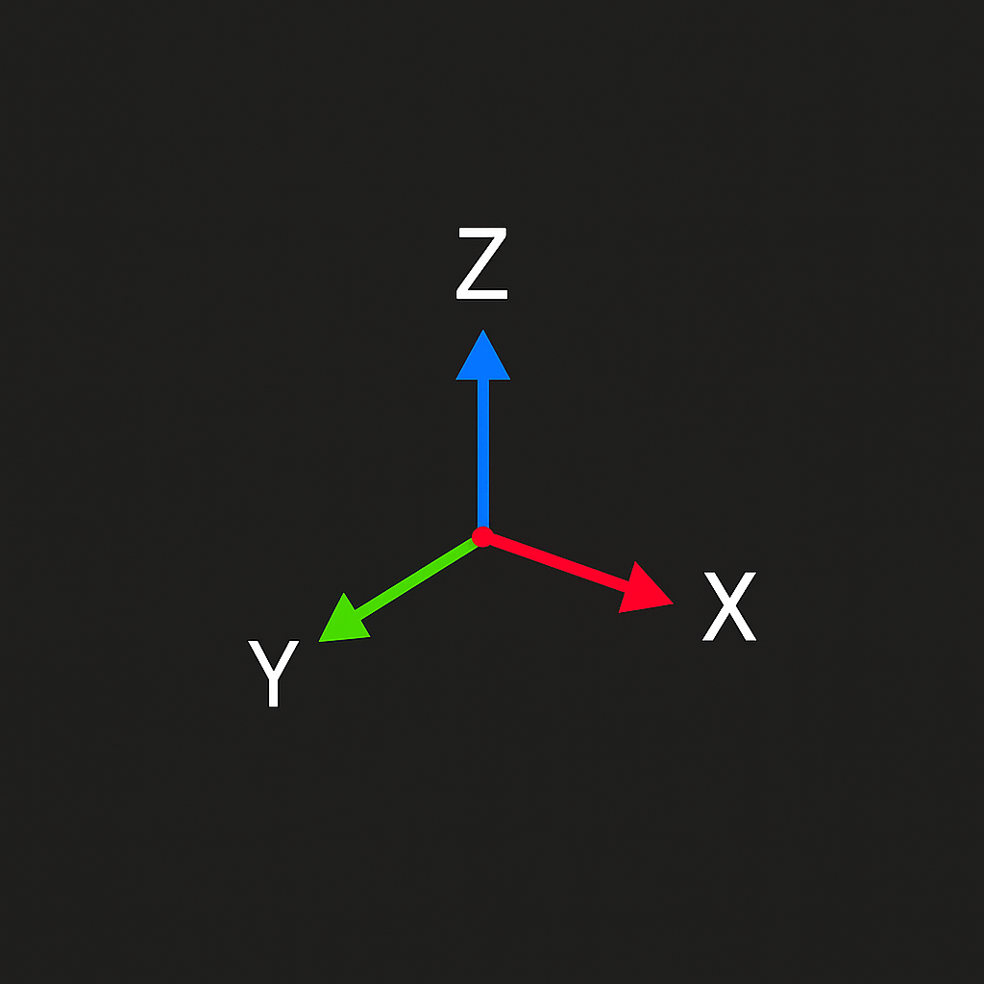
Basic Statistics – Min, Max, Mean
Used to understand:
The size of the cloud
The center point
How spread out the data is
Formulas :
min_coords = points.min(axis=0)
max_coords = points.max(axis=0)
mean_coords = points.mean(axis=0)
What you get:
min_x, min_y, min_z → Smallest values
max_x, max_y, max_z → Largest values
mean_x, mean_y, mean_z → Average (center)

Slide 30
Scaling (Min-Max Scaling)
Purpose: Resize the point cloud into a fixed range (e.g., 0 to 1)
Formula: X_scaled = (X - X_min) / (X_max - X_min)
Do this for X, Y, and Z separately
Use for:
Matching display space
Input to ML models
Removing unit mismatches (cm vs m)

Slide 31
Normalization
Purpose:
Move the point cloud to the center and scale to standard size
1.Centering: X_centered = X – mean
2. Scaling: X_normalized = X_centered / max(|X_centered|)
Result:
Cloud is centered at (0,0,0)
Fits within a unit cube (-1 to 1)
Used before ML training or aligning clouds

Slide 32
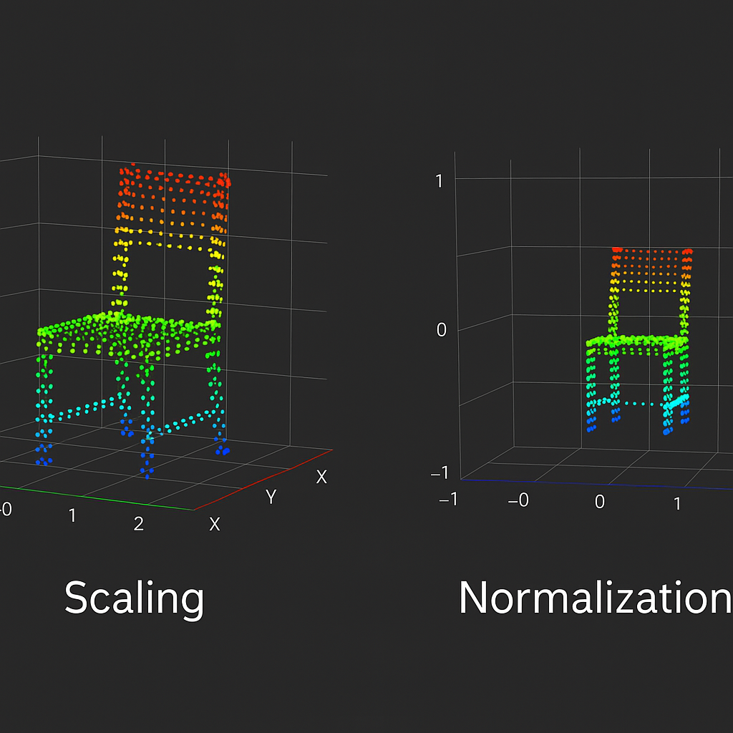
Scaling and Normalization
Scaling just changes the size — like zooming in or out. Normalization shifts the point cloud to the center and resizes it to fit within a box from -1 to 1, so it’s easier to compare with other clouds.”
The chair has now
been centered at the origin (0, 0, 0)
resized to fit within a unit cube
from -1 to +1 on all axes

Slide 33
Standardization
Transforms point cloud data so:
Mean = 0
Standard deviation = 1
Makes all axes centered and equally scaled
Formula: (X_standardized = (X - μ) / σ)
standardized_value = (value - mean) / std_dev
Apply to x, y, z individually
Used for machine learning and statistical analysis

Slide 34
Outlier Detection (Noise Removal)
What are Outliers?
Points far from the main structure of the cloud
Usually caused by noise, reflections, or sensor errors
Checks how far each point is from its neighbors
Removes those that are too isolated

Slide 35
Visualization Techniques
Tools:
Open3D
CloudCompare
MeshLab
PCL Viewer
What You Can View:
Color by height or intensity
Bounding boxes / coordinate axes
Normals (surface directions)
Before/After filtering comparison
Always visualize before and after processing

Slide 36
Working with Point Cloud Tools

Slide 37
Objectives :
Understand key tools used for point cloud data
Learn to install and set up tools
Perform basic processing like noise removal and downsampling

Slide 38
Tool Overview – Open3D, PCL, and ROS RViz
Open3D
Python-based library
Used for point cloud loading, visualization, filtering, etc.
Very beginner-friendly
PCL (Point Cloud Library)
C++ library for advanced point cloud processing
Supports segmentation, filtering, alignment, etc.
Requires some programming setup
ROS RViz
Part of ROS (Robot Operating System)
Real-time 3D visualization tool
Great for viewing LiDAR and robot data in robotics

Slide 39
Installing Open3D
Steps to Install Open3D (Python):
pip install open3d
Works on Windows, Linux, Mac
Best for beginners with Python knowledge
You can use Jupyter Notebook or plain Python scripts

Slide 40
Installing PCL – C++ Library
Available via system packages (Linux):
sudo apt install libpcl-dev
Requires:
C++ compiler (GCC)
CMake for building
Advanced use; best for robotics and performance-critical applications

Slide 41
ROS RViz Setup
Install ROS (e.g., Noetic) on Ubuntu:
sudo apt install ros-noetic-desktop-full
Comes with RViz pre-installed
Best for roboticists visualizing sensor data like LiDAR

Slide 42
Load and View Point Cloud in Open3D
Python Example:
import open3d as o3d
pcd = o3d.io.read_point_cloud("yourfile.pcd")
o3d.visualization.draw_geometries([pcd])
This opens a 3D viewer window
You can rotate, zoom, and explore the point cloud

Slide 43
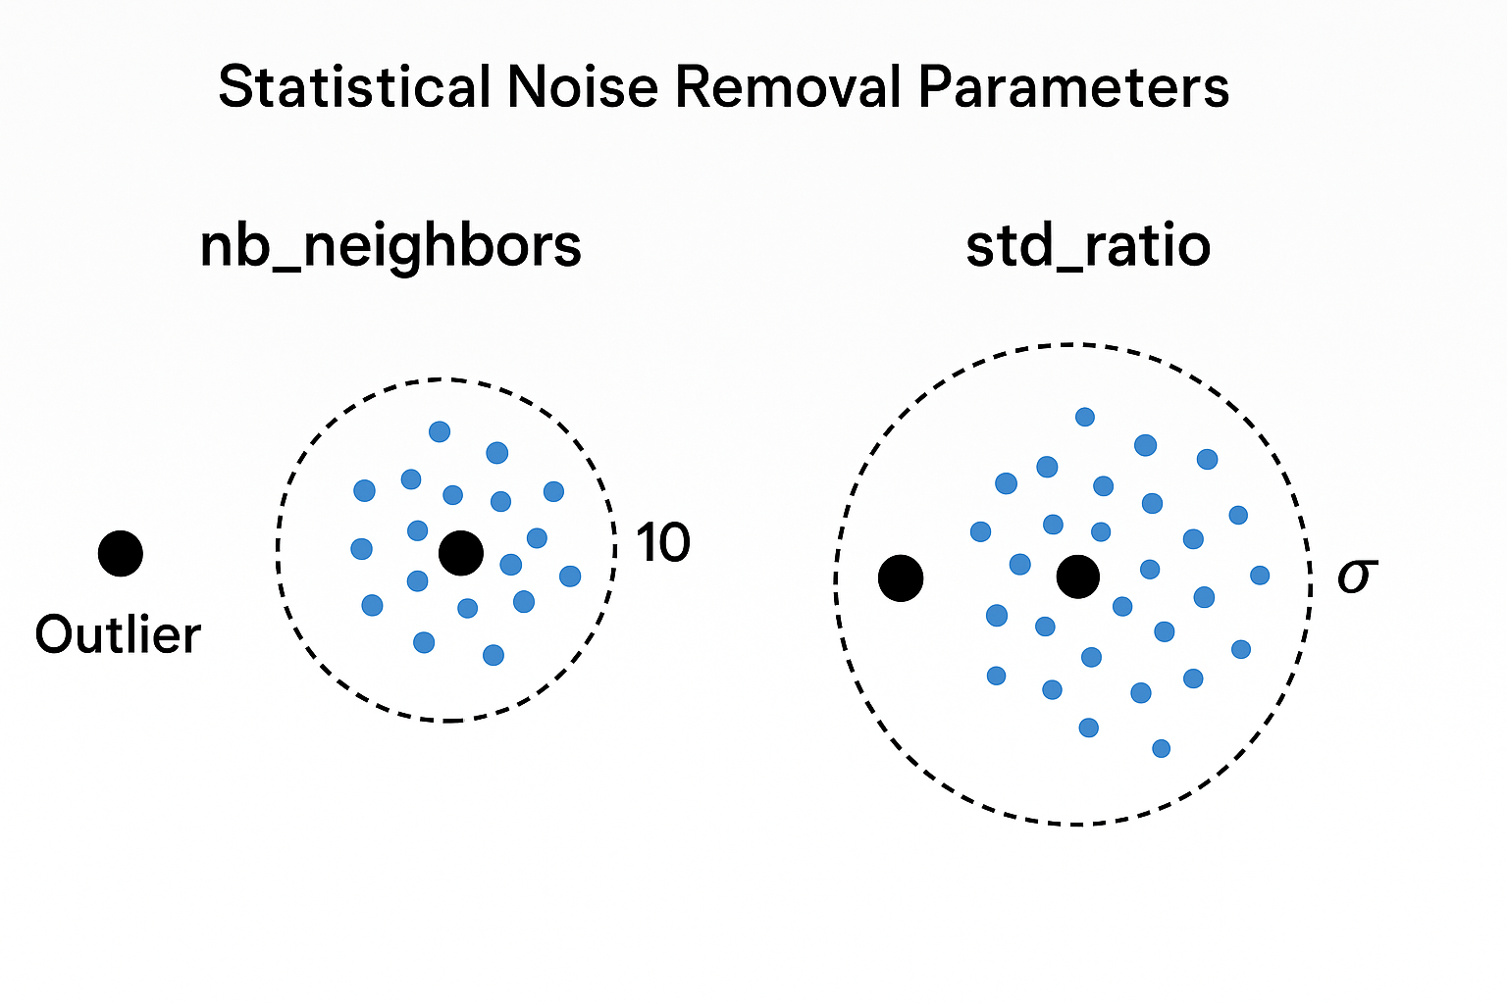
Remove Noise – Clean the Data
Why?
Point clouds often have random isolated points → not useful
Use Statistical Outlier Removal:
clean_pcd, ind = pcd.remove_statistical_outlier(nb_neighbors=20, std_ratio=2.0)
o3d.visualization.draw_geometries([clean_pcd])
Removes noisy, scattered points
Makes your data cleaner and easier to work with

Slide 44
Why?
Too many points = slow processing
We only need enough to represent the shape
How it works:
Break 3D space into small cubes (voxels)
Keep 1 point per cube, remove extras
down_pcd = pcd.voxel_down_sample(voxel_size=0.05)
o3d.visualization.draw_geometries([down_pcd])
Faster processing
Smaller file size
Still preserves shape

Slide 45
Save the Processed Cloud
o3d.io.write_point_cloud("cleaned_output.pcd", down_pcd)
Save your filtered or downsampled cloud to use later
Can be opened again in Open3D or other tools

Slide 46
Point Cloud Preprocessing Concepts

Slide 47
Objectives :
Customize PointCloud Visualization (Color, Size, Background)
Use RViz with ROS
Play PointClouds using a ROS Bag File
Live Demo + Hands-On Practice

Slide 48
What is a .bag File?
.bag = "ROS bag file" — like a black box recorder for robots
Stores sensor data, TF, images, GPS, LiDAR, etc.
Used for playback and offline debugging
Plays back data as if the robot is alive again

Slide 49
Playing a ROS Bag File
Open a terminal
Run: rosbag play -l <your_file.bag>
-l means loop continuously
Topics get published as if the robot is alive again

Slide 50
Launching RViz
To start RViz: run rviz in a terminal
Left panel → “Displays”
Top area → “Global Options” for Fixed Frame and Background

Slide 51
Add PointCloud2 Display in RViz
Click “Add” → Choose PointCloud2
Set Topic: /Lidar1PointCloud (or other topic)
Set Fixed Frame: map (or base_link if applicable)
Adjust view → You should see the cloud

Slide 52
Customize – PointCloud Visualization
In PointCloud2 settings:
Color Transformer: RGB / Intensity / FlatColor
Size (m): 0.03 to 0.1
Style: Points
Alpha: 1.0 (fully visible)

Slide 53
Customize – RViz Background
Go to “Global Options”
Change Background Color
Use Light Gray / Black for better contrast

Slide 54
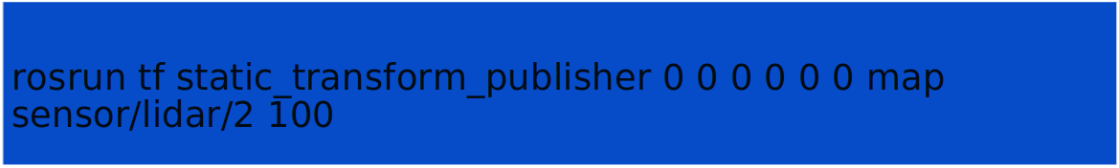
Multiple PointClouds
Add multiple PointCloud2 displays
Set topics: /Lidar1PointCloud, /Lidar2PointCloud, etc.
Publish static transforms for each one
Example :

Slide 55
Recap & Key Takeaways
RViz is essential for debugging & visualization
Color and size customization improves clarity
Always check:
Topic name
Frame ID
Static TF link to map or base_link
Use .bag playback for safe offline testing

Slide 56
Visualization Deep Dive (RViz + ROS)

Slide 57
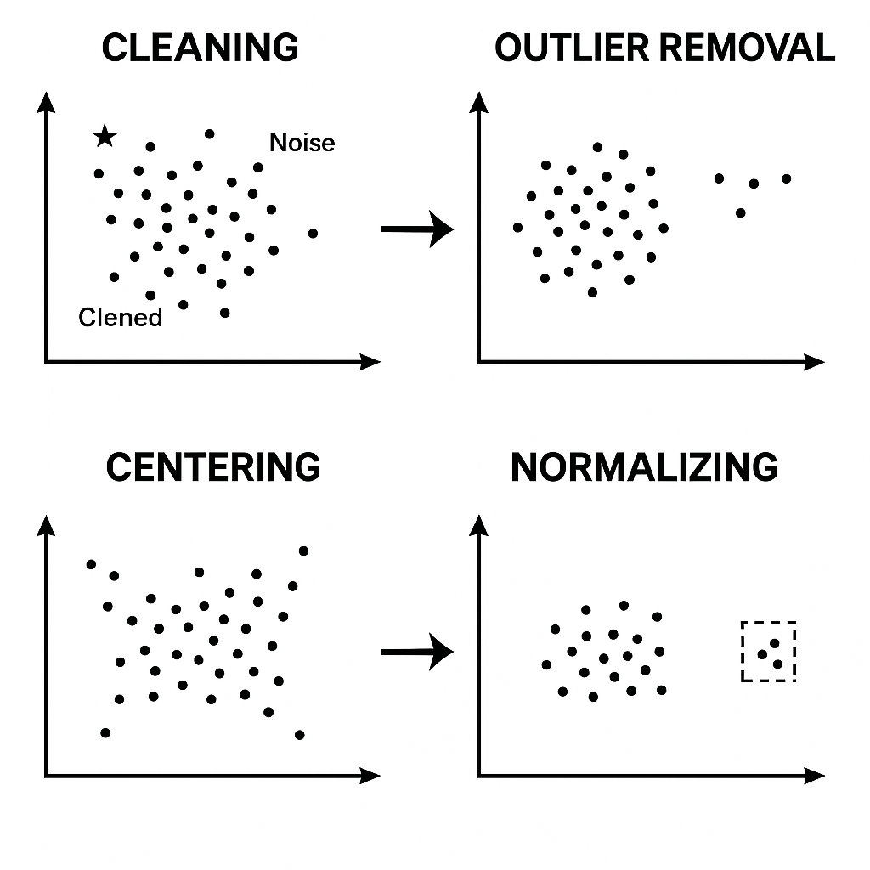
What is Point Cloud Preprocessing?
Few Points :
Preprocessing = cleaning and preparing raw 3D point data
Makes the cloud usable for analysis, visualization, or machine learning
We use it on our sample file: 1398110231.025_ascii.pcd

Slide 58
Step 1 – Cleaning (Removing NaNs and Noise)
Raw point clouds can contain NaNs or invalid values
These points do not represent real objects
Removing them improves stability and quality
In Python with Open3D:
pcd.remove_non_finite_points()

Slide 59
Step 2 – Outlier Removal
Some points may be isolated or flying in space
They don’t belong to surfaces (like walls or objects)
2 Common Methods:
Statistical Outlier Removal
Radius Outlier Removal
pcd, ind = pcd.remove_statistical_outlier(nb_neighbors=20, std_ratio=2.0)

Slide 60
Step 3 – Centering
The point cloud may be located far from the origin
Centering moves the cloud so its "middle" is at (0,0,0)
This helps with visualization and alignment
Example:
center = np.mean(np.asarray(pcd.points), axis=0) pcd.translate(-center)

Slide 61
Step 4 – Normalizing
Normalizing scales the cloud into a standard size (unit sphere or cube)
Useful for machine learning, comparison, or visualization
Makes different clouds consistent in size
Example:
points = np.asarray(pcd.points)
scale = np.max(np.linalg.norm(points, axis=1))
points /= scale
pcd.points = o3d.utility.Vector3dVector(points)

Slide 62
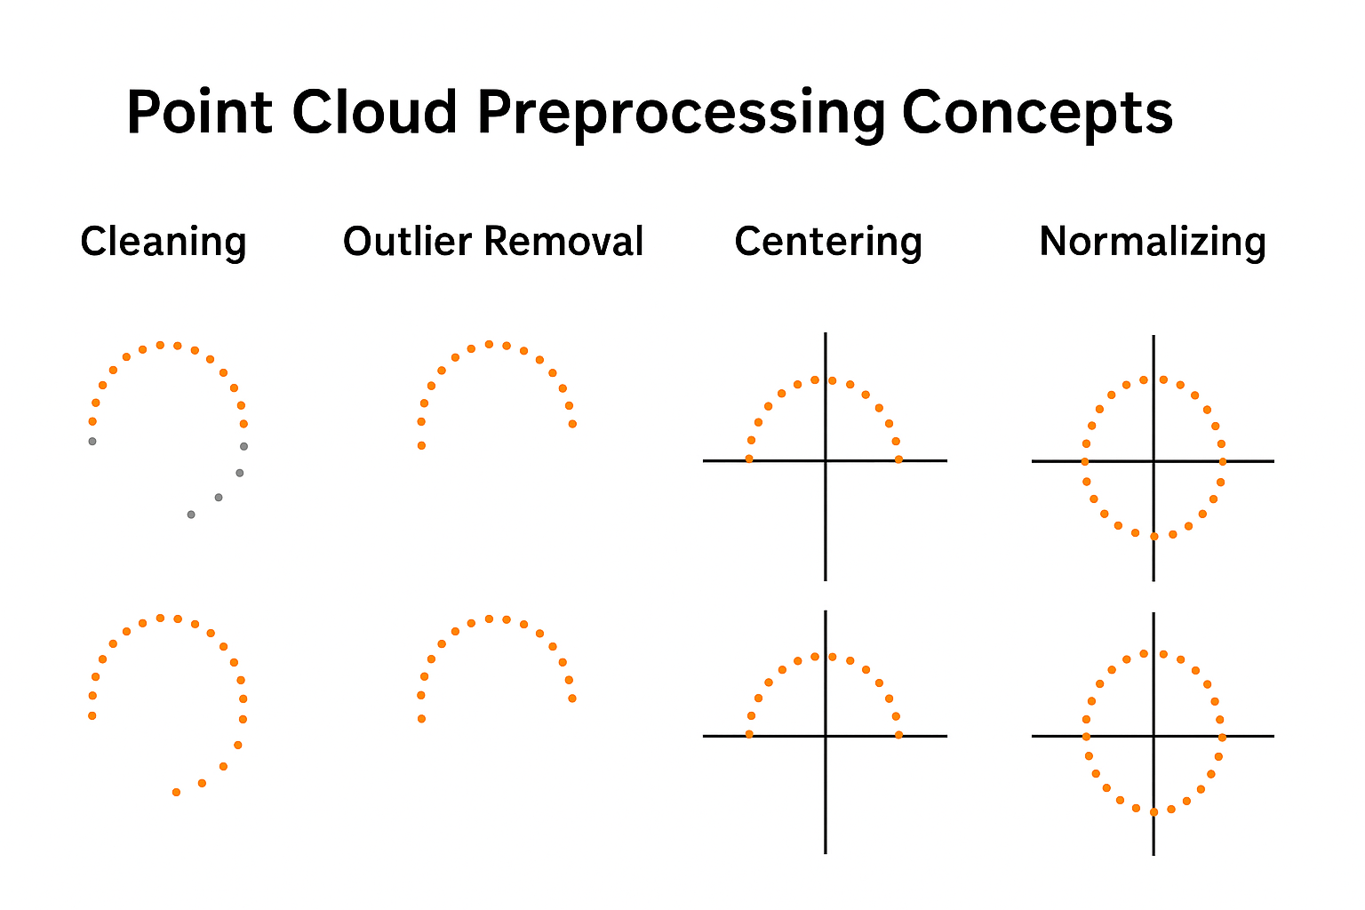
How it Works ?
Sample Visualization

Slide 63
Summary of Preprocessing Steps
Tool used: Open3D (Python)
Step | Purpose
Cleaning | Remove NaNs or invalid points
Outlier Removal | Remove noise and stray points
Centering | Move cloud to origin (0,0,0)
Normalizing | Scale cloud to fit within a unit boundary

Slide 64
Filtering Methods

Slide 65
Objectives :
filtering Methods
Radius Outlier filtering
statistical filtering
Visualization Befor/After filtering

Slide 66
Introduction to Point Cloud Filtering
Point clouds often contain outliers (stray/noisy points)
These can come from:
Reflections
Sensor glitches
Wrong depth readings
Goal: Remove unwanted points while keeping shape intact

Slide 67
Why Is Filtering Important?
Removes stray “flying” points
Improves processing speed
Boosts accuracy for:
SLAM
Object detection
3D reconstruction
Helps make point cloud clean, compact, and usable

Slide 68
Types of Filtering Techniques
You will learn:
Radius Outlier Filtering
Statistical Outlier Filtering
And how to visualize the difference

Slide 69
Radius Outlier Filtering – Concept
Checks:
“How many nearby points are within a fixed radius?”
If a point has fewer neighbors than threshold, it's removed
Simple but may miss dense outliers
Radius Outlier Filtering – How It Works ?
Parameters:
nb_points: Minimum number of neighbors
radius: Distance to check
Example :
Only keeps points with ≥5 neighbors within 10cm
pcd, ind = pcd.remove_radius_outlier(nb_points=5, radius=0.1)

Slide 70
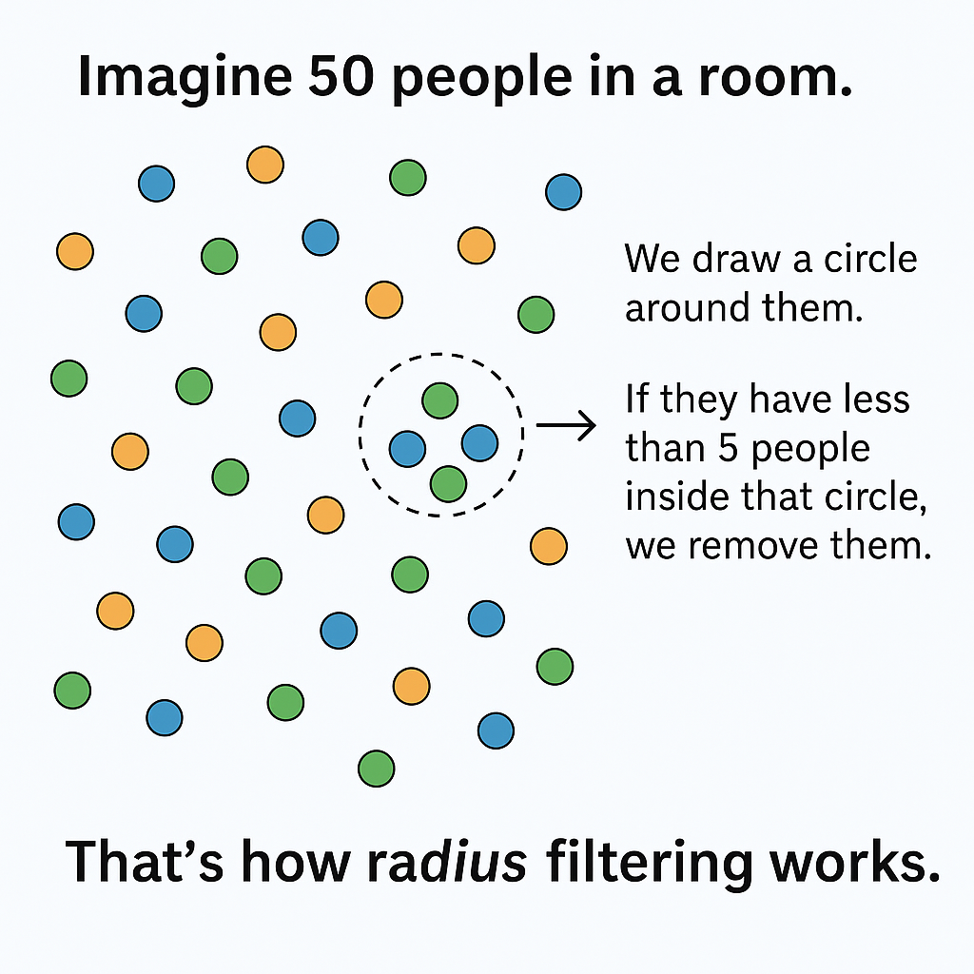
Radius Filtering – Real-World Analogy
Example:
Imagine 50 people in a room. For every person, we draw a circle around them. If they have less than 5 people inside that circle, we remove them. That’s how radius filtering works.

Slide 71
Statistical Outlier Filtering
Looks at distance to neighbors
If a point is too far away from the average, it's removed
Uses standard deviation for thresholding
Smarter and more consistent

Slide 72
Statistical Filtering – How It Works
Parameters:
nb_neighbors: Number of nearest points to use
std_ratio: Acceptable deviation from average
Example:
Keeps points that fall within 2 standard deviations from mean distance
pcd, ind = pcd.remove_statistical_outlier(nb_neighbors=20, std_ratio=2.0)

Slide 73
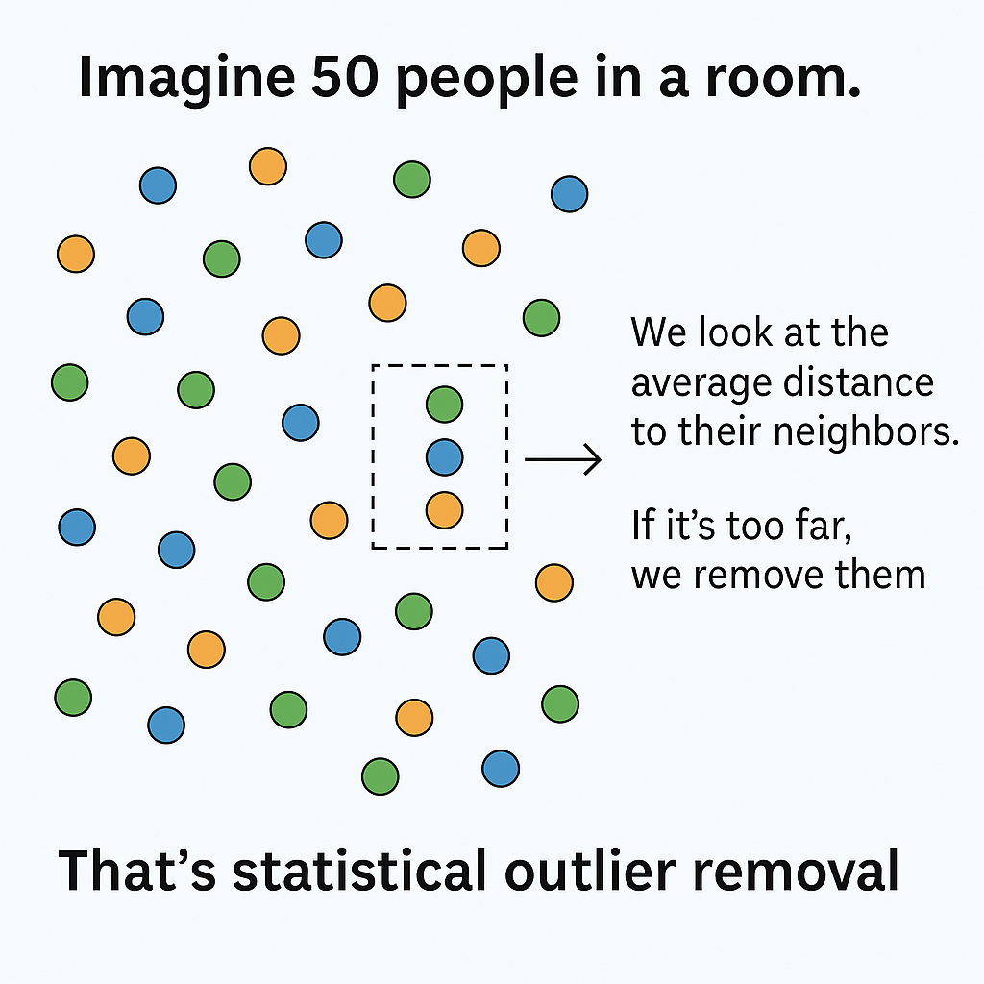
Statistical Filtering – Real-World Analogy
Imagine:
If most people in a group stand 1 meter apart, and one person is 10 meters away, they're not really part of the group. So we remove them.

Slide 74
Before & After Visualization
Step | Output
Original cloud | Noisy cloud with outliers
After Radius Filter | Fewer floating points, but some remain
After Statistical | Cleaner cloud with tight surface grouping

Slide 75
Python :
o3d.visualization.draw_geometries([pcd]) # original
pcd_radius, _ = pcd.remove_radius_outlier(5, 0.1)
o3d.visualization.draw_geometries([pcd_radius])
pcd_stat, _ = pcd.remove_statistical_outlier(20, 2.0)
o3d.visualization.draw_geometries([pcd_stat])

Slide 76
Which One Should I Use?
Situation | Best Filter
You want fast, simple cleanup | Radius Outlier
You want better accuracy | Statistical Filter
Working on small local cloud | Radius Outlier
Cleaning large scene globally | Statistical Filter

Slide 77
voxelization & DownSampling

Slide 78
Day - 10
why downsample?
voxel grid filters
Uniform Downsampling

Slide 79
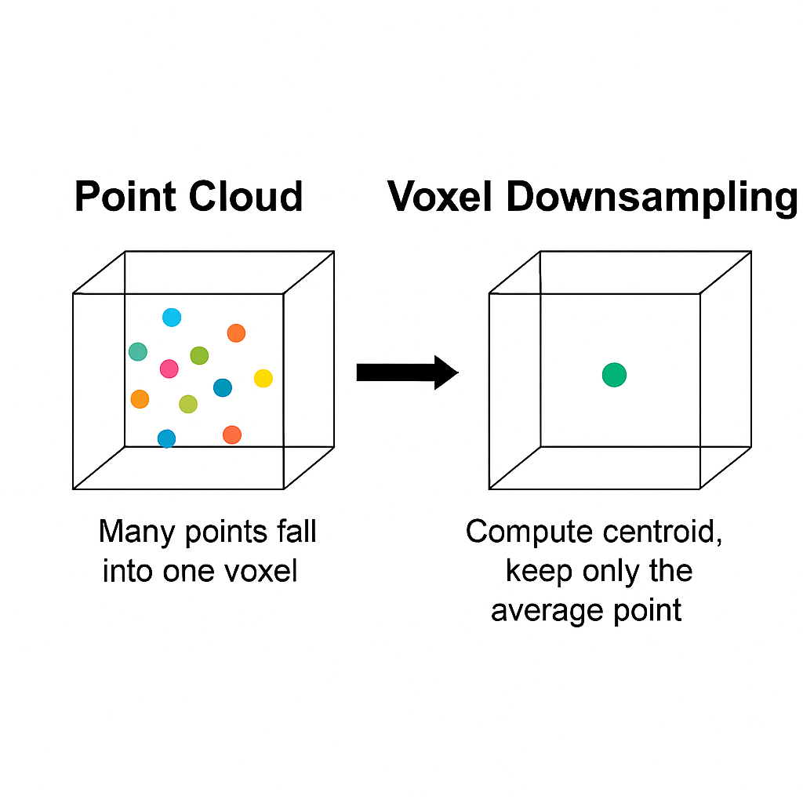
What is Voxel Grid Filtering?
Voxel Grid Filtering is a method of downsampling a point cloud by dividing the 3D space into small cubes (called voxels) and replacing all points inside each voxel with one point — usually the average (centroid) of the points.

Slide 80
Key Idea:
Instead of storing all the original points, you:
Cut the space into a grid of small cubes
In each cube (voxel), you keep just one point
That one point represents all the others in that cube

Slide 81
Why Use It?
Purpose | Benefit
Reduce data size | Faster computation & less memory
Remove redundancy | Nearby points get merged
Speed up processing | Ideal for SLAM, mesh, ML pipelines
Uniform sampling | Helps create structured clouds

Slide 82
How It Works :
Choose a voxel size (e.g., 0.05 meters)
Break the 3D space into a grid of cubes
For each cube:
Check how many points fall inside
Compute the average position (x, y, z)
Keep only 1 point
Discard the rest

Slide 83
Example in Python (Open3D):
import open3d as o3d
pcd = o3d.io.read_point_cloud("sample.pcd")
voxel_down = pcd.voxel_down_sample(voxel_size=0.05)
o3d.visualization.draw_geometries([voxel_down])

Slide 84
What Does Voxel Size Mean?
It defines the size of each 3D cube (voxel) used to group points.
Example:
voxel_size = 0.05 → Each voxel is a cube of 5 cm × 5 cm × 5 cm
voxel_size = 0.10 → Each voxel is 10 cm per side
The smaller the voxel size, the more detail you preserve. The larger the voxel size, the more aggressive the downsampling.

Slide 85
How to Choose the Voxel Size?
Situation | Recommended Voxel Size
LiDAR car data (large scenes) | 0.1 to 0.5 meters
Indoor mapping | 0.02 to 0.1 meters
3D object models / meshes | 0.005 to 0.05 meters
Fast processing with rough shape | 0.1+ meters
High precision for ML/meshing | 0.01–0.02 meters

Slide 86
Which term should you use?
Open3D (Python)
voxel_down_sample()
PCL (C++)
VoxelGrid filter class
Point cloud papers
"voxelization" or "voxelized cloud"

Slide 87
Two common methods:
Voxel Grid Downsampling
Uniform Downsampling

Slide 88
Why Downsample?
Large point clouds are slow and heavy
Many points are redundant (very close together)
Downsampling keeps the overall shape, but reduces size
Helps in:
Visualization
Mesh reconstruction
Machine learning & segmentation

Slide 89
What is Uniform Downsampling?
Keeps every Nth point in the point cloud (e.g., every 5th point)
Based on index, not spatial location
Very fast, but may lose important structure
Best for previews or debugging
Example:
pcd.uniform_down_sample(every_k_points=5)

Slide 90
When Uniform Downsampling IS Useful ?
Situation | Why it's useful
You want to quickly reduce point count | Super fast and easy
Doing a quick test or preview | You just need a rough cloud
Debugging or prototyping code | You don’t need full detail
Working with structured point clouds (like grids or ordered scans) | Downsampling stays relatively balanced

Slide 91
When It's Not Recommended ?
Uniform Down Sampling :
Situation | Why it’s risky
You need to preserve 3D structure | It removes points blindly
Feeding into ML or feature extraction | You might lose important features
Doing meshing, registration, or surface fitting | Missing points can cause artifacts

Slide 92
Voxel vs Uniform Downsampling
Feature | Voxel Grid | Uniform Downsampling
Based on position? | Yes | No (based on index)
Preserves structure? | Mostly | Risk of random loss
Speed | Fast | Very fast
Use case | Accurate simplification | Rough preview/debugging

Slide 93
When to Use Each ?
Use voxel grid filtering when:
You need structure-preserving simplification
Preparing data for ML, meshing, registration
Use uniform downsampling when:
You want a quick, light version of the cloud
Previewing or testing a pipeline

Slide 94
Estimating Normals

Slide 95
Estimating Normals in Point Clouds
Normals describe the surface direction at each point in a point cloud
They are essential for surface reconstruction, shading, and understanding object orientation
In this session, we’ll cover:
What normals are
How they’re estimated
KNN vs Radius neighborhood methods
Visualization techniques

Slide 96
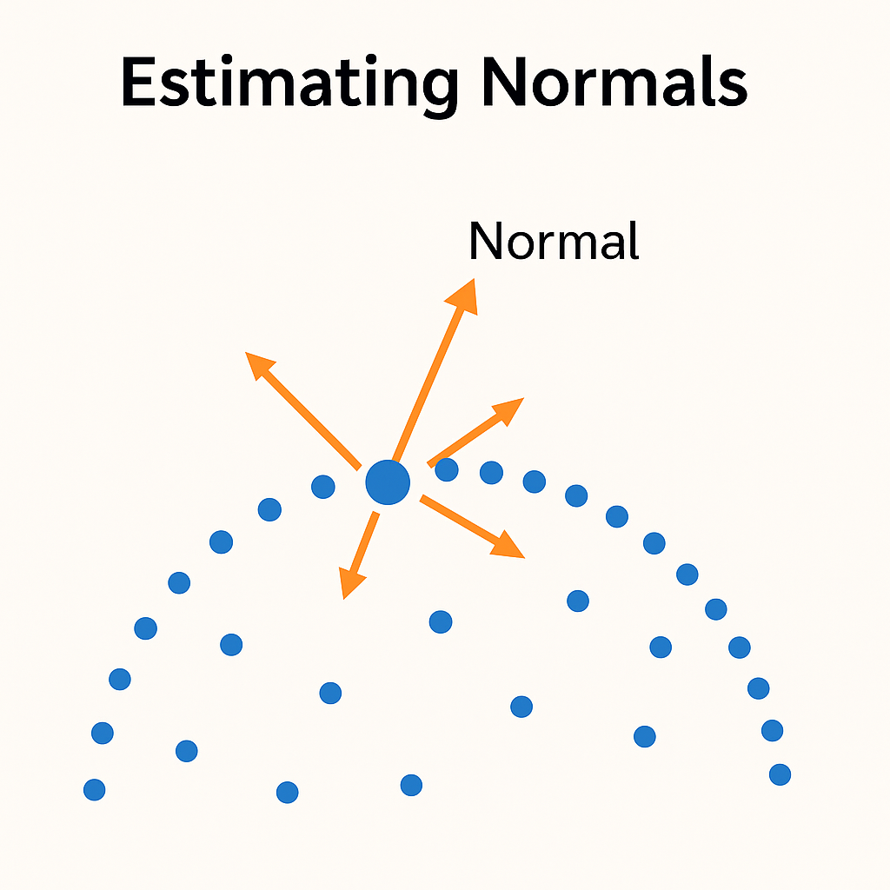
What Are Normals?
A normal is a small arrow that points perpendicular to the surface at a point
Every point in a cloud can have its own normal
Think of it like grass blades growing out of the surface
Why Normals Matter:
For shading and rendering
For surface/mesh reconstruction
For robot perception and pose estimation
For understanding surface geometry

Slide 97
How Are Normals Estimated?
We don’t have surfaces — just points — so we guess normals using nearby points
Estimation Process:
Pick a point
Find its neighboring points
Fit a small plane through those neighbors
The vector perpendicular to that plane = normal

Slide 98
Neighborhood Selection – KNN vs Radius
KNN is like asking your 30 closest friends.
Radius is like asking everyone within 1 meter of you.
Choosing the right method affects the quality of normals.
Method | Description | Best For
KNN | Use a fixed number of nearest neighbors (e.g., K = 30) | Uniform-density clouds
Radius | Use all neighbors within a fixed radius (e.g., R = 0.1 m) | Uneven or sparse clouds

Slide 99
Visualizing Normals
Normals are shown as short arrows growing out from each point
Useful for:
Detecting noisy areas
Debugging surface direction
Preparing for mesh generation
Open3D Code:
Downsample point cloud before estimating/visualizing normals.
o3d.visualization.draw_geometries([pcd], point_show_normal=True)

Slide 100
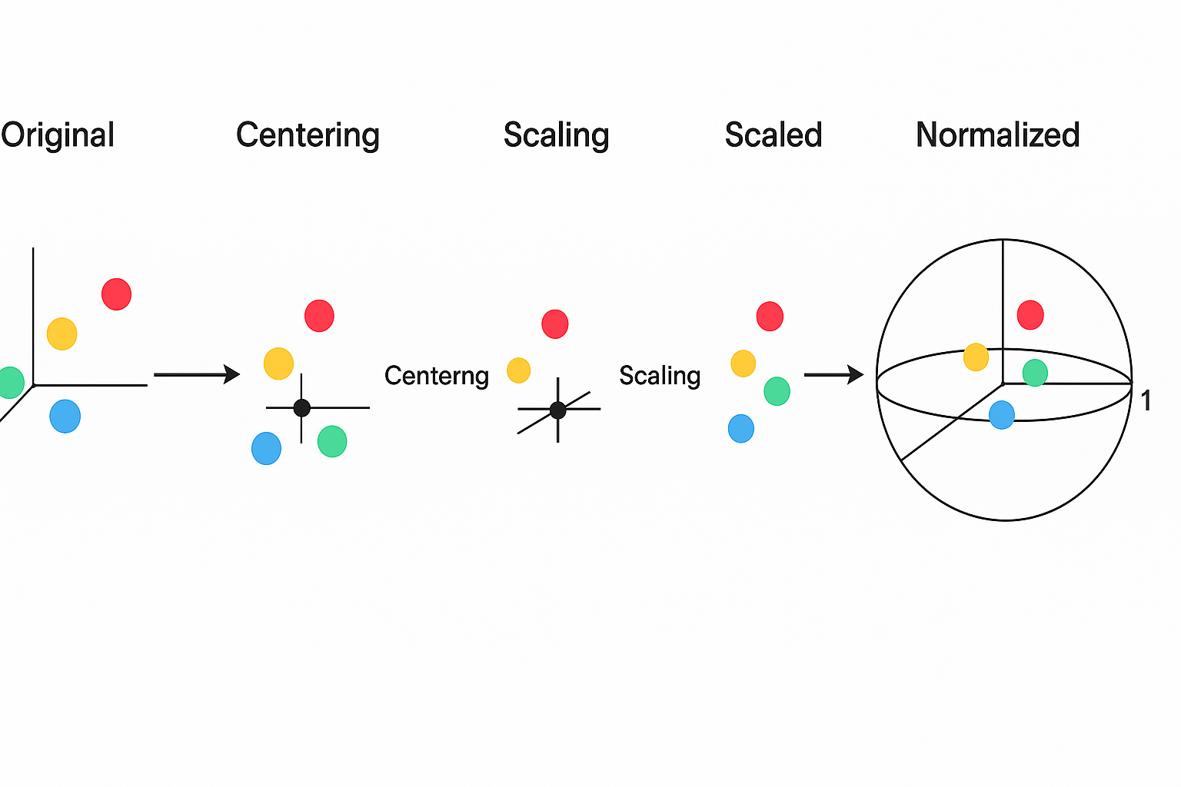
Centering and Normalizing Before Normals
Normalization = Centering + Scaling to unit size

Slide 101
sequence of Normalizing :
Center the point cloud → Subtract the mean from all points to shift the cloud to (0, 0, 0)
Scale (Normalize) the point cloud → Find the maximum distance from the origin → Divide all points by that distance → So the farthest point is now exactly at distance = 1
Why is this done in order?
If you don’t center the cloud first, your max distance will be from the wrong "middle"
That will lead to incorrect normalization, where the cloud is shifted or stretched oddly

Slide 102
Why is this Normalization done in order?
If you don’t center the cloud first, your max distance will be from the wrong "middle"
That will lead to incorrect normalization, where the cloud is shifted or stretched oddly
Overall:
To normalize a cloud, we first center it so it’s sitting on the origin. Then we scale it down so all the points fit neatly inside a small space — like a ball with radius 1.

Slide 103
Point Cloud Transformations

Slide 104
Overview
Transformations allow us to move, rotate, and scale point clouds in 3D space
These are essential for aligning, visualizing, and analyzing 3D data
Main types of transformations:
Translation
Rotation
Scaling
Full transformation using a 4×4 matrix

Slide 105
Translation
Translation (Moving the Point Cloud)
Shifts the entire point cloud in space without changing shape or direction
Example:
Result: The whole cloud moves to a new position
pcd.translate((3, 0, 1)) # Move 3 units in X, 1 unit up (Z)

Slide 106
Rotation
Rotation (Turning the Point Cloud)
Rotates the point cloud around X, Y, or Z axis
Example:
Result: The cloud turns 45° around the Z-axis
R = pcd.get_rotation_matrix_from_xyz((0, 0, np.pi / 4)) pcd.rotate(R, center=(0, 0, 0))

Slide 107
Scaling
Scaling (Resizing the Point Cloud)
Changes the size of the point cloud without moving its center
Example:
Result: The cloud becomes smaller or larger, but keeps shape
pcd.scale(0.5, center=pcd.get_center()) # Shrinks to half size

Slide 108
What is a 4×4 Transformation Matrix?
A 4×4 transformation matrix is a single matrix that can apply:
Rotation
Translation
Scaling to a point cloud — all at once.
Scaling we can consider as optional

Slide 109
The Structure:
| R11 R12 R13 Tx | ← Rotation + Translation
| R21 R22 R23 Ty |
| R31 R32 R33 Tz |
| 0 0 0 1 | ← Padding row (required)
What It Does :
Rotates the point cloud (R part)
Translates it to a new position (T part)
Keeps it structured as a single command
Component | Meaning
R11 to R33 | Rotation matrix (3×3)
Tx, Ty, Tz | Translation vector (how much to move)
Bottom row | Used for math — keeps the format consistent in 3D space

Slide 110
Apply a Transformation Matrix in Open3D
T = np.eye(4) T[:3, :3] = pcd.get_rotation_matrix_from_xyz((0, 0, np.pi / 4)) # 45° rotation T[:3, 3] = [2, 0, 1] # Translate in X and Z pcd.transform(T)
Python :
Applies rotation and translation together in one shot

Slide 111
Matrix Composition (Multiple Transforms)
You can combine transforms by multiplying matrices:
Python :
Order matters — Rotation before Translation ≠ Translation before Rotation
T_final = T3 @ T2 @ T1 pcd.transform(T_final)

Slide 112
Verify Changes in RViz
o3d.io.write_point_cloud("transformed_sample.pcd", pcd)
Save transformed cloud:
Publish in ROS:
Open RViz:
Set Fixed Frame = map
Add PointCloud2, select /cloud_pcd
View the position, direction, and size
We can see the cloud shifted, rotated, and resized in RViz’s 3D space.
rosrun pcl_ros pcd_to_pointcloud transformed_sample.pcd 1.0 _frame_id:=map

Slide 113
Advanced Visualization and Annotation

Slide 114
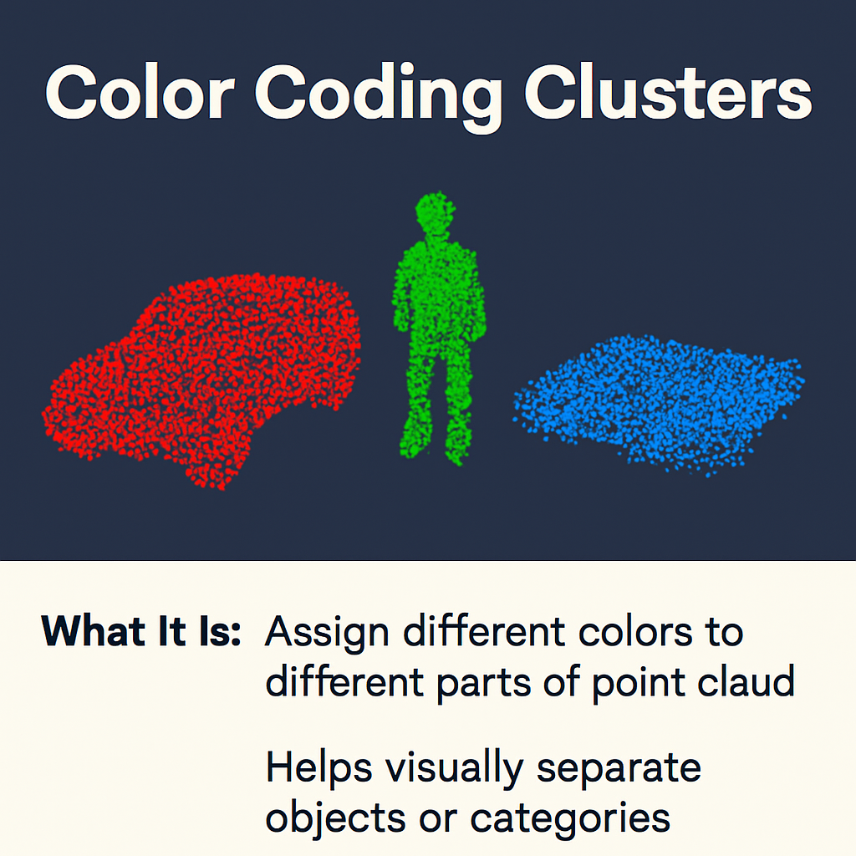
Advanced Visualization and Annotation
Goal: Enhance point cloud understanding by visually highlighting different elements
We’ll learn to:
Color clusters or classes
Add annotations (lines, boxes)
Export screenshots of our visualizations

Slide 115
Color Coding Clusters or Classes
What It Is:
Assign different colors to different parts of a point cloud
Helps visually separate objects or categories
Why It’s Useful:
Makes clustering or segmentation results easy to see
Used in labeling cars, pedestrians, buildings, etc.
Hands-on:
import numpy as np import open3d as o3d colors = [[1, 0, 0], [0, 1, 0], [0, 0, 1]] # Red, Green, Blue for i, cluster in enumerate(clusters): # clusters = list of PointClouds cluster.paint_uniform_color(colors[i])

Slide 116
Adding Annotations – Lines Between Points
What It Is:
Draws a line connecting two points (e.g., path, direction)
Why It’s Useful:
Show routes, measurements, object relationships
Hands-on:
from open3d.geometry import LineSet line = LineSet(points=..., lines=...)

Slide 117
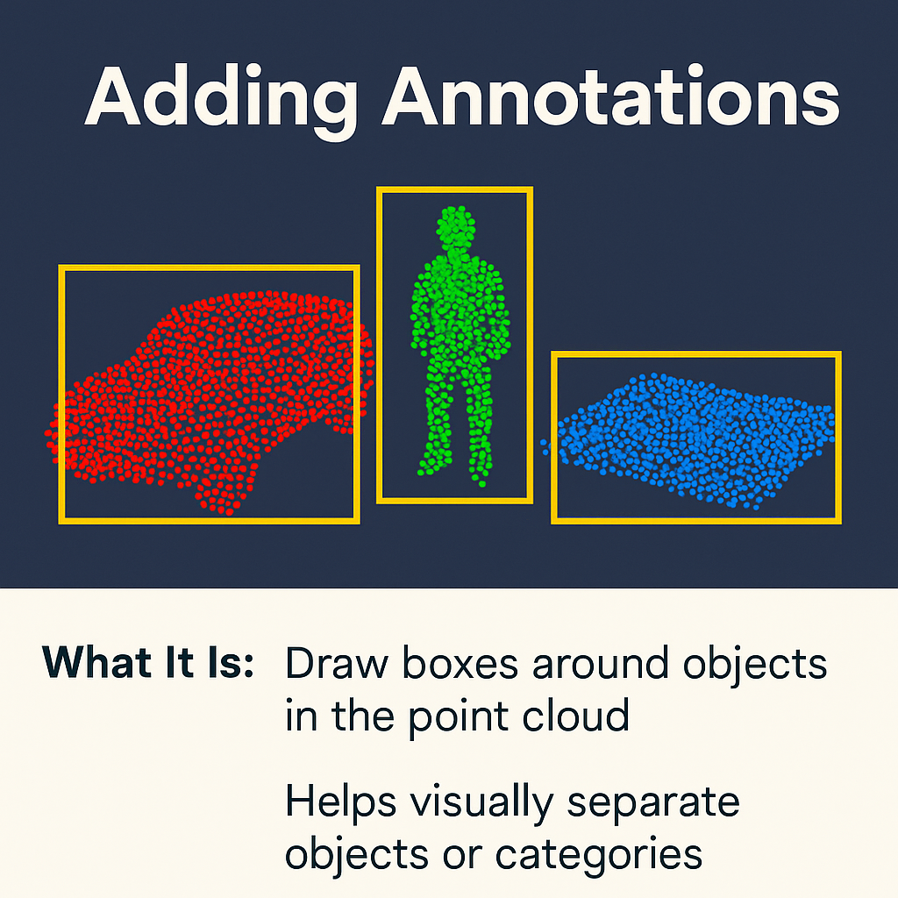
Bounding boxes help highlight and isolate objects in a point cloud (e.g., cars, people, surfaces)
They make objects easier to identify and analyze by visually separating them from the background

Slide 118
Exporting Images or Screenshots
What It Is:
Save a screenshot of your visualized scene
Why It’s Useful:
Create reports, share results, or document output
Hands-on:
Use after coloring, boxing, or adding lines.
vis.capture_screen_image("output.png")

Slide 119
Why It Matters
Feature | What It Does | Use Case
Color Coding | Visually separates groups or classes | Object segmentation
Boxes | Show where an object is in 3D space | Detection, object tracking
Lines | Connect important points | Paths, angles, relationships
Export | Capture the current view | Reports, sharing, debugging

Slide 120
Segmentation Basics

Slide 121
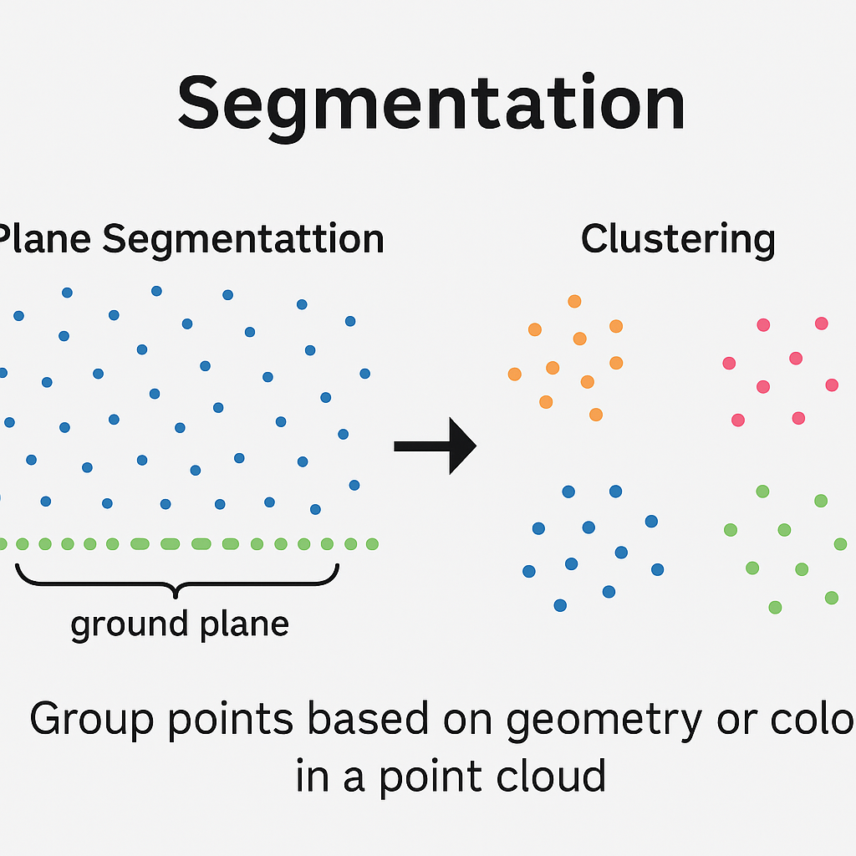
What is Segmentation?
Segmentation is the process of dividing a point cloud into separate, meaningful groups of points.
Helps identify individual objects or surfaces in a 3D scene.
It is a critical step before object detection, labeling, or tracking.
Example: In a point cloud of a street, segmentation helps split:
Points of cars
Points of pedestrians
Points of buildings or road

Slide 122
Why Do We Need Segmentation?
Real-world point clouds are messy and unstructured.
Segmentation makes them easier to analyze and process.
Application | Benefit
Object Detection | Detect cars, humans, trees, etc.
Scene Understanding | Understand different parts of scene
Robot Navigation | Avoid obstacles, plan path

Slide 123
Common Types of Segmentation
Type | Description | Example Use Case
Clustering | Groups points based on distance or density | Object separation
Plane Segmentation | Identifies flat surfaces (e.g., floor) | Ground or table detection
Region Growing | Expands based on smoothness/similarity | Wall or surface segmentation
Semantic Segmentation | Uses AI to assign class labels | Label road, car, person

Slide 124
What is Clustering-Based Segmentation?
One of the simplest and most used segmentation methods
Groups points that are close together in space
Output: a set of clusters where each cluster = 1 object
Example: In a crowd scene, each person forms a cluster

Slide 125
Clustering-Based Segmentation
The most common and simple form of segmentation
Clusters are formed based on distance between points
Common algorithms:
DBSCAN
Euclidean Clustering

Slide 126
Introduction to DBSCAN Clustering
DBSCAN = Density-Based Spatial Clustering of Applications with Noise
It finds clusters based on how tightly packed the points are
Points too far from any group are treated as noise
It needs two parameters:
eps: Distance threshold to find neighbors
min_points: Minimum points required to form a cluster

Slide 127
How DBSCAN Works
Pick a point
Look around within radius eps
If min_points neighbors found → form a cluster
Expand the cluster to include all reachable points
Points that don’t belong to any cluster → marked as noise

Slide 128
Clustering and Labeling

Slide 129
Objective
Goal :
Use DBSCAN to cluster a point cloud, color each cluster, and remove noise points.
We'll learn:
How to apply DBSCAN in code
How to visualize clusters with different colors
How to remove noise/outlier points

Slide 130
Apply DBSCAN in Open3D
Python :
What Does This Code Do?
Applies DBSCAN clustering on the point cloud
Assigns a label to every point based on its cluster
How to Count Clusters:
total_clusters = labels.max() + 1
Add +1 because cluster IDs start from 0
labels = np.array(pcd.cluster_dbscan(eps=0.2, min_points=10, print_progress=True))
Label | Meaning
0 | Cluster 0 (first detected object)
1 | Cluster 1
2 | Cluster 2
... | More clusters
-1 | Noise point (does not belong to any group)

Slide 131
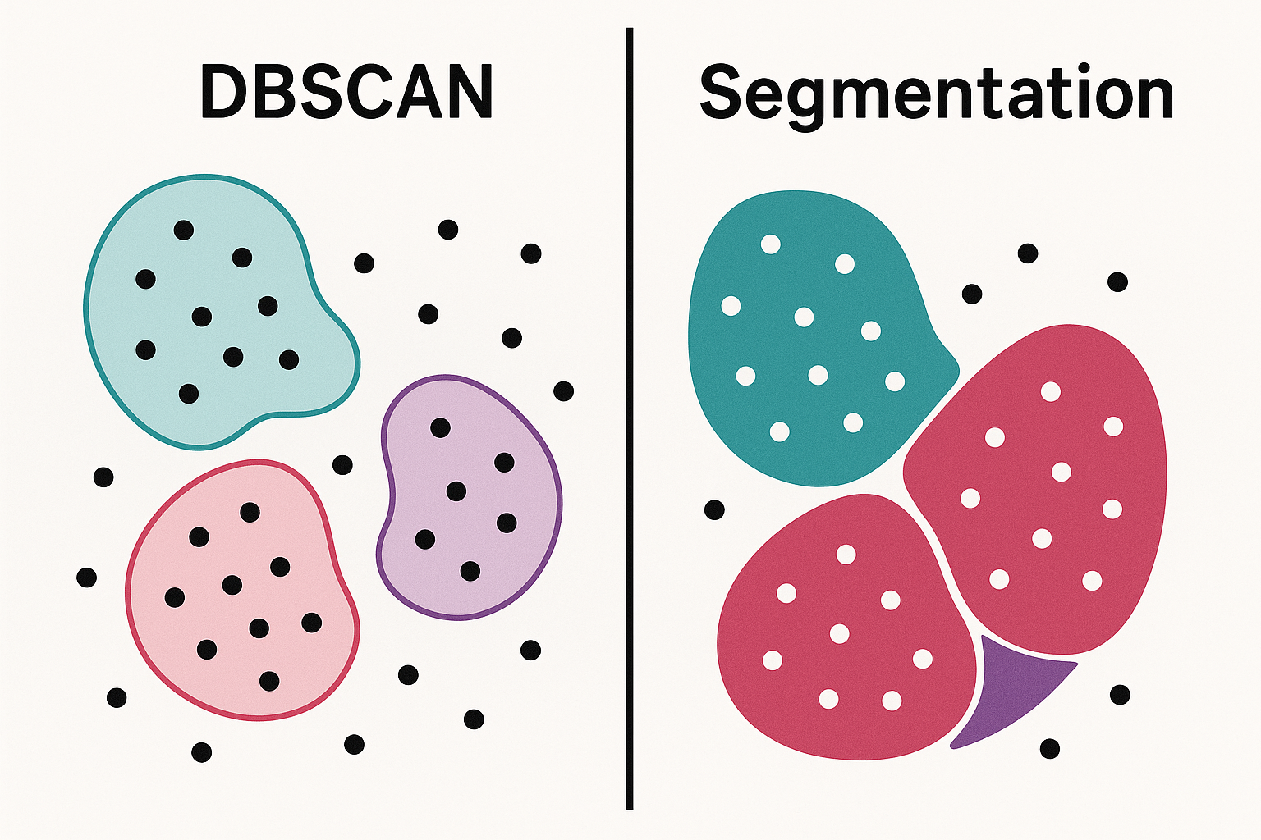
Example:
1000 points in total
4 detected clusters → labels 0, 1, 2, 3
150 points labeled -1 → considered noise
Use these labels to:
Color each cluster differently
Remove noise points
Analyze individual objects in the scene

Slide 132
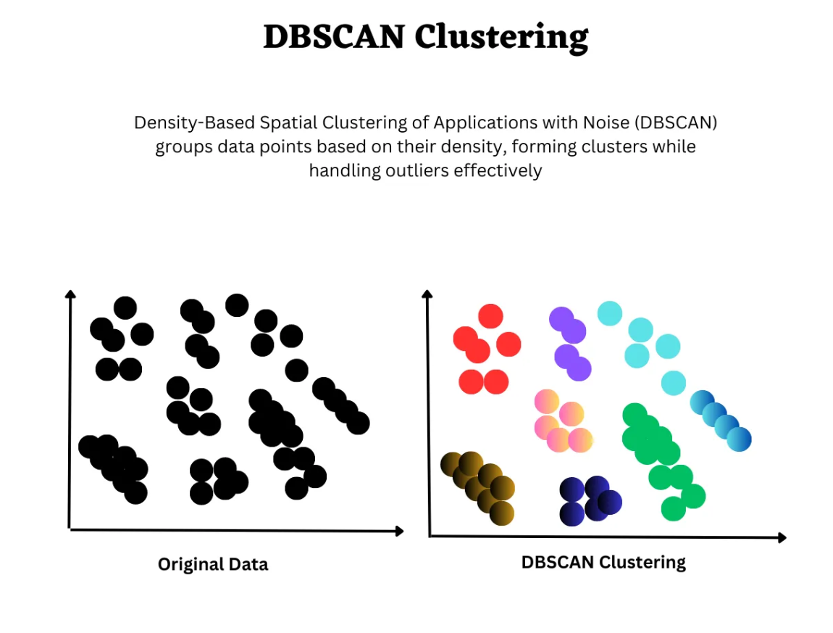
How it looks ?

Slide 133
Color Each Cluster Differently
import matplotlib.pyplot as plt max_label = labels.max() colors = plt.get_cmap("tab20")(labels / (max_label + 1)) colors[labels < 0] = [0, 0, 0] # Color noise as black pcd.colors = o3d.utility.Vector3dVector(colors[:, :3])
Python
This makes each cluster visually distinct
Use this for visualization in RViz or Open3D

Slide 134
Remove Noise Points
To keep only valid clusters (no noise):
This filters out all points labeled -1 (noise)
Keeps only clustered objects
clean_indices = np.where(labels >= 0)[0] pcd_clean = pcd.select_by_index(clean_indices)

Slide 135
Summary
Step | What It Does
Apply DBSCAN | Group nearby points into clusters
Color by Label | Assign unique color to each group
Remove Noise (opt.) | Delete scattered, irrelevant points

Slide 136
Bounding Boxes & Geometric Calculations

Slide 137
Bounding Boxes & Geometric Calculations
Topics Covered:
AABB (Axis-Aligned Bounding Box)
OBB (Oriented Bounding Box)
Centroid and volume calculations

Slide 138

cloud of points in 3D
Imagine you have a cloud of points in 3D — like dots floating in space, forming the shape of an object (e.g., a chair, box, or rock).
Then :
How do we measure that shape?
How do we describe its size, position, or orientation?
How do we wrap it in something simple to work with?
Bounding boxes and centroid help us do exactly that.

Slide 139
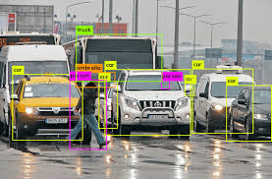
What are Bounding Boxes?
Bounding boxes (AABB & OBB) help us wrap complex point cloud shapes inside simple boxes to make processing and understanding easier.
Purpose of Bounding Boxes ?
Simplify complex 3D objects
Estimate size, position, and center
Speed up calculations
Used in object detection, tracking, and grasping

Slide 140
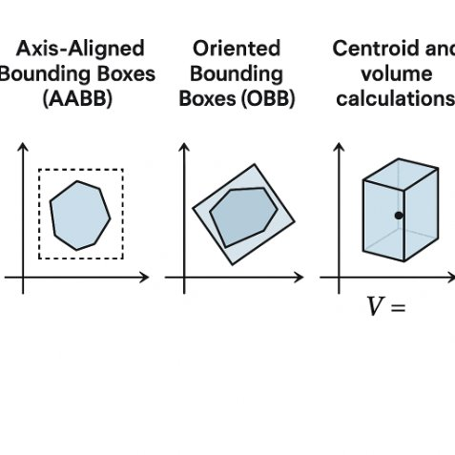
How it looks ?

Slide 141
AABB – Axis-Aligned Bounding Box
What is AABB?
AABB is a box that tightly fits around the object
Its edges are always aligned with X, Y, Z axes
So it’s like a box standing straight — no rotation
Why use it?
It’s very fast to calculate
Useful when we want a quick estimate of where an object is
Easy to use in filtering, cropping, collision detection
aabb = pcd.get_axis_aligned_bounding_box() aabb.color = (1, 0, 0) # Red Volume of the AABB: aabb_extent = aabb.get_extent() # [Length, Width, Height] volume_aabb = np.prod(aabb_extent) print("AABB Volume:", volume_aabb)

Slide 142
OBB – Oriented Bounding Box ?
What is OBB?
OBB is also a box, but it can rotate
It fits the object more tightly, even if it’s diagonal or tilted
It’s like wrapping the object with a box that turns with it
Why use it?
More accurate than AABB
Used in robotics for things like grasping or packaging
Helpful when objects are not axis-aligned
obb = pcd.get_oriented_bounding_box() obb.color = (0, 1, 0) # Green Volume of the OBB: obb_extent = obb.extent volume_obb = np.prod(obb_extent) print("OBB Volume:", volume_obb)

Slide 143
What is Centroid?
What is Centroid?
The centroid is the average of all point positions
Think of it as the balance point of the shape
Why use it?
Helps us know where the center of the object is
Useful for placing labels, or anchoring something
centroid = np.mean(np.asarray(pcd.points), axis=0) print("Centroid:", centroid)

Slide 144
Visualize Everything Together ?
What we see when we visualize:
The original point cloud shape
A red box around it (AABB)
A green, tilted box (OBB)
We know the center (centroid) and volume of each box
Visualization : o3d.visualization.draw_geometries([pcd, aabb, obb])

Slide 145
Real-Life Analogy
Concept | Real-Life Analogy
AABB | A straight box placed flat on a table
OBB | A tilted box that hugs the object perfectly
Centroid | Balance point of the object
Volume | How much water the box could hold

Slide 146
Key Takeaways
AABB: Fast and simple for filtering
OBB: Precise, handles rotation, great for robotics
Centroid: Finds object center
Volume: Helps filter or sort objects

Slide 147
Distance Measures & Metrics

Slide 148
Objectives :
Euclidean distance between clouds/points
Distance to planes (e.g., ground plane)

Slide 149
Euclidean Distance Between Points
It's the straight-line distance between two points in space.
Like using a scale to measure from one point to another — the shortest possible path.
Example: If we have p1 = [1, 2, 3]
p2 = [4, 5, 6]
Then:
This line:
Subtracts the two points: [4-1, 5-2, 6-3] = [3, 3, 3]
Computes the length of the resulting vector, which is the distance.
distance = np.linalg.norm(np.array(p1) - np.array(p2))

Slide 150
Distance Between Two Point Clouds ?
You want to know how far each point in one cloud is from the nearest point in another cloud.
How do we do that?
For each point in Cloud A, find the nearest point in Cloud B using KDTree
Then compute Euclidean distance between them
Helps compare similarity or alignment of two clouds
Sample Code:
pcd_tree = o3d.geometry.KDTreeFlann(pcd2) for point in pcd1.points: [_, _, dists] = pcd_tree.search_knn_vector_3d(point, 1)

Slide 151
KDTree – Fast Nearest Neighbor Search
KDTree is a data structure that allows fast search of nearby points
Especially useful when working with large point clouds
Used with Euclidean distance to find closest points efficiently
KDTree is helpful for ?
Comparing how two shapes differ
Checking alignment errors
Change detection in point clouds

Slide 152
Distance to a Plane ?
Why measure distance to a plane?
To know how high a point/object is from the ground or some flat surface
First: Detect the Plane :
This uses RANSAC to find the best flat surface in your cloud (like the floor or a table).
You get values: a, b, c, d
That define the plane equation: Ax + By + Cz + D = 0
plane_model, inliers = pcd.segment_plane(...)

Slide 153
Plane Fitting using RANSAC (Open3D)
Then:
Measure distance of any point to the plane
Code example :
RANSAC is used to fit a plane even when there are noisy points
Randomly picks points, fits many planes, and keeps the best one
Helps find clean ground surfaces in real-world clouds
distance = |Ax + By + Cz + D| / sqrt(A^2 + B^2 + C^2)
plane_model, inliers = pcd.segment_plane( distance_threshold=0.01, ransac_n=3, num_iterations=1000 )

Slide 154
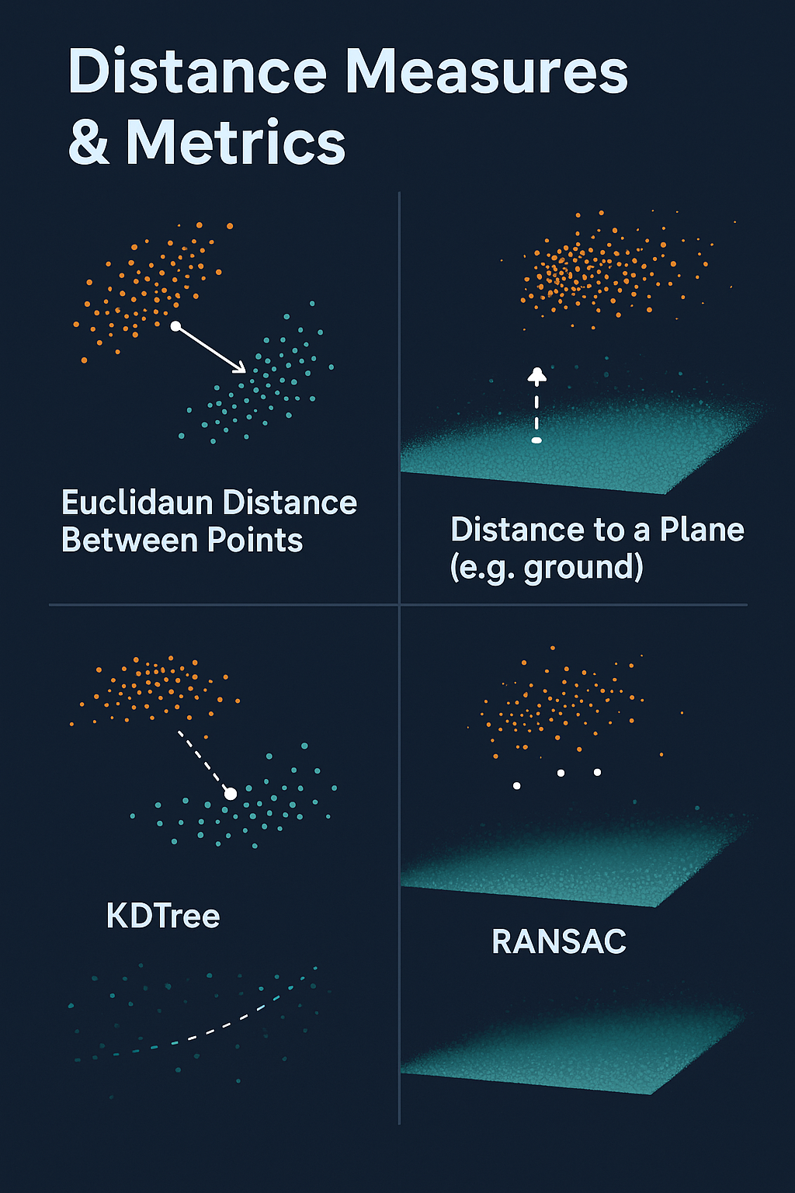
Distance Measures & Metrics – Visual
Euclidean Distance ⟶ Straight-line distance between two 3D points
KDTree ⟶ Quickly finds nearest neighbors using spatial indexing
Distance to Plane ⟶ Measures point height from a flat surface (like ground)
RANSAC ⟶ Fits the best plane by ignoring noisy/outlier points

Slide 155
Data Preparation for Deep Learning

Slide 156
Objectives :
Normalize and scale data
Downsample to fixed point counts (e.g., 1024)
Format conversion (.pcd → .npy)

Slide 157
Normalize and Scale Point Cloud
Centering: Shift the cloud so its centroid is at the origin
Scaling: Scale all points to fit inside a unit sphere (radius = 1)y
Helps deep learning models learn better by removing scale/position bias
center = np.mean(points, axis=0) points -= center
max_dist = np.max(np.linalg.norm(points, axis=1)) points /= max_dist

Slide 158
Downsample to Fixed Number of Points (e.g., 1024)
Deep learning models (like PointNet) need fixed-size inputs
1024 is commonly used because:
It balances detail and speed
Matches research standards (e.g., PointNet)
Sampling:
if len(points) >= 1024: indices = np.random.choice(len(points), 1024, replace=False) else: indices = np.random.choice(len(points), 1024, replace=True) sampled = points[indices]

Slide 159
Format Conversion: .pcd → .npy
.npy is a fast, compact format used in deep learning libraries
Easily saves and loads point cloud arrays
To Save:
To Load Later:
np.save("cloud_sample.npy", sampled)
data = np.load("cloud_sample.npy")

Slide 160
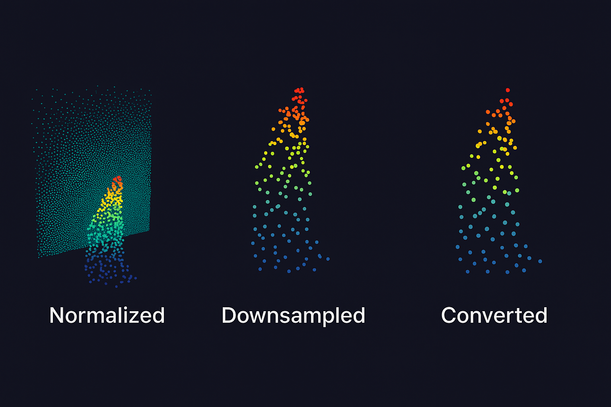
How it looks ?
start by centering and scaling the point cloud (normalize it).
Then we reduce the number of points (downsample to 1024).
Finally, we save it in .npy format so it’s ready for deep learning.”

Slide 161
Key Steps
Step | Purpose
Normalize + Scale | Center cloud, remove size/position bias
Downsample to 1024 | Ensure fixed input size for model
Save as .npy | Efficient data storage for training

Slide 162
Thank You

